Slide 1

Populations Hake stocks aDNA

Slide 2
Quality Control
Quality Filter | N◦ Removed SNP
Not mapped | 2
Low quality (Missing data) | 2
Total analysed SNPs | 26
N◦ Removed ancient Samples
11
43
41

Slide 3
Archaeological Samples | Time Period
LLR-03-AR9 | Middle Ages
LLR-04-MAL1 | Middle Ages
LLR-05-AR10 | Middle Ages
LLR-08-AR11 | Middle Ages
LLR-10-PO17 | Early Modern
LLR-11-AT2 | Early Modern
LLR-14-BCN2 | Middle Ages
LLR-18-AR7 | Middle Ages
LLR-19-LU1 | Neolithic
LLR-20-TA23 | Middle Ages
LLR-21-CD8 | Early Modern
LLR-22-BCN5 | Early Modern
LLR-23-AR8 | Early Modern
LLR-26-i | Roman
LLR-28-M4 | Middle Ages
LLR-30-g | Roman
LLR-32-A4 | Middle Ages
LLR-33-SA3 | Early Modern
LLR-35-A5 | Middle Ages
LLR-39-M3 | Middle Ages
LLR-40-A2 | Middle Ages
LLR-42-TA22 | Middle Ages
LLR-43-LU3 | Neolithic
LLR-44-M2 | Middle Ages
LLR-46-R11 | Early Modern
LLR-48-TA7 | Middle Ages
LLR-53-M1 | Middle Ages
LLR-56-b | Roman
LLR-57-AT4 | Early Modern
LLR-58-n | Roman
LLR-61-MAL7 | Middle Ages
LLR-62-R5 | Early Modern
LLR-63-R3 | Early Modern
LLR-68-TB1 | Middle Ages
LLR-69-R10 | Early Modern
LLR-70-M5 | Middle Ages
LLR-73-M6 | Middle Ages
LLR-75-R2 | Early Modern
LLR-78-A1 | Middle Ages
LLR-80-k | Roman
LLR-86-a | Roman

Slide 4
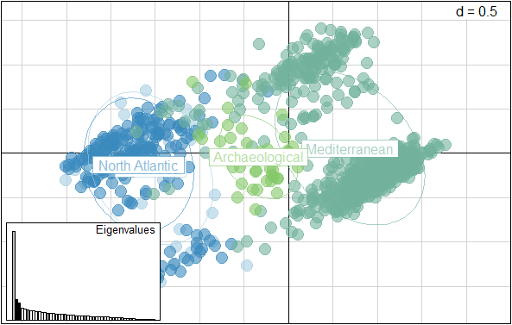
PCA Hakes (Axis 1 and 2). North Atlantic and North Sea Population overlap, Archaeological and Mediterranean samples differentiate but share similar characters.
Percentages of Eigenvalues
PC | head(eig.perc)
1 | 26.498772
2 | 6.061413
3 | 5.152587
4 | 3.620065
5 | 3.393056
6 | 2.954217

Slide 5
Fst Values (calculation index to compare population variations of hakes)
Fst values closest to 1 explain that there is no overlap of allele frequencies between the population. Values closer to 0 denotes high similarity between clusters.
 | North Sea | North Atlantic | Mediterranean
North Sea | NA | NA | NA
North Atlantic | 0.0574 | NA | NA
Mediterranean | 0.3312 | 0.3577 | NA
Modern populations
 | North Sea | North Atlantic | Mediterranean | Archaeological
North Sea | NA | NA | NA | NA
North Atlantic | 0.0358 | NA | NA | NA
Mediterranean | 0.1975 | 0.2048 | NA | NA
Archaeological | 0.2267 | 0.2278 | 0.1913 | NA
Modern vs Past populations

Slide 6
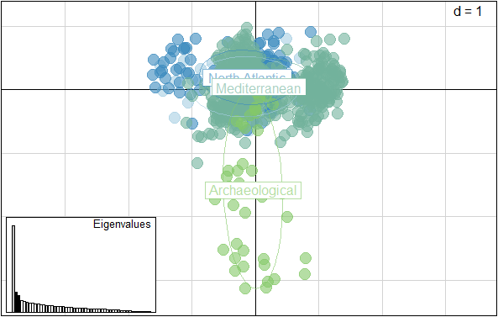
PCA Hakes (Axes 2 and 3). Axis 3 differentiates archaeological samples from modern stocks.

Slide 7
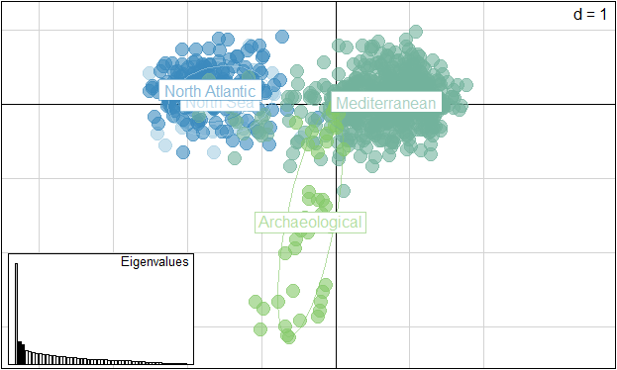
PCA Hakes (Axes 1 and 3). Axis three seems to differentiates the stocks influenced by time periods while axis 1 seems to separate the stocks by shared SNPs

Slide 8
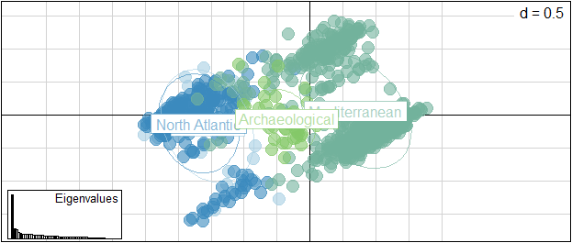
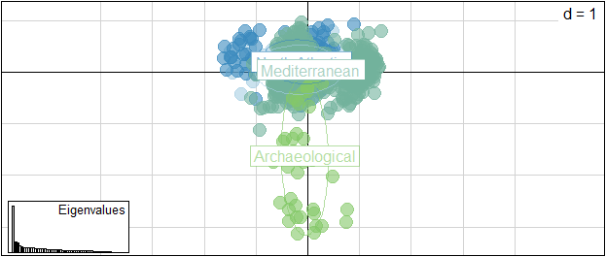
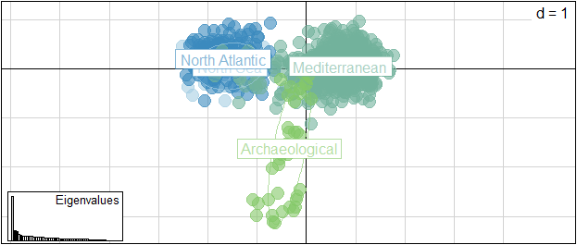
43 samples, excluding Neolithic

Slide 9
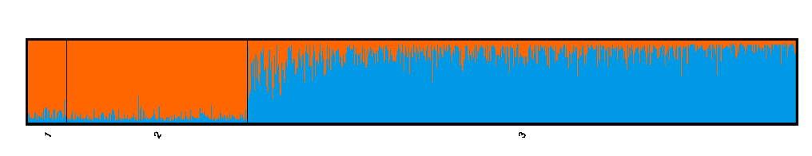
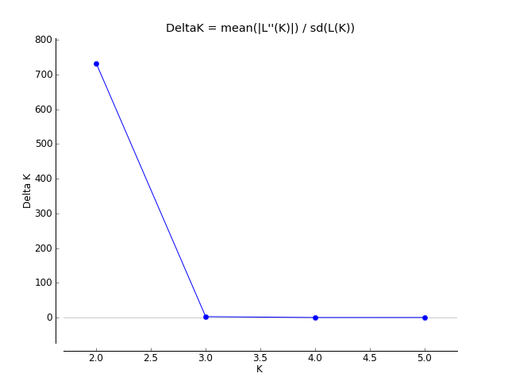
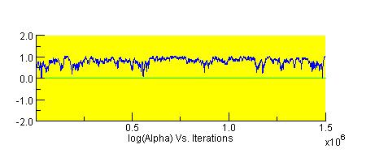
Population Structure Analyses between Modern Hake Populations
1 = North Sea subpopulation (NS), 2 = North Atlantic subpopulation (NA) and 3=Mediterranean subpopulation (MED).
Delta K shows the presence of two clusters K=2. MCMC was 1000 000 after 500 000 runs.
Alpha >0, denotes admixed populatons

Slide 10
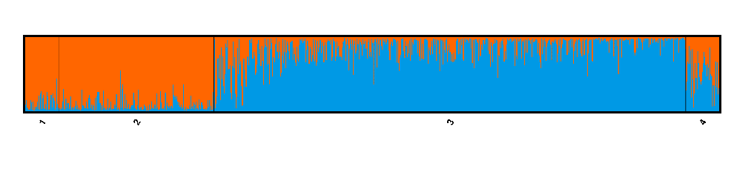
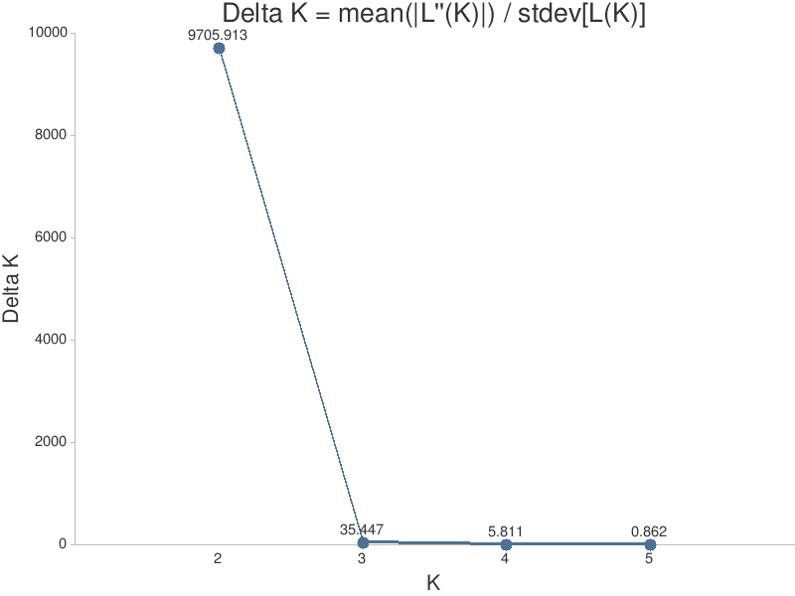
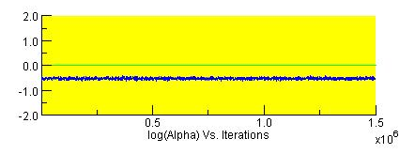
Population Structure Analyses between Modern vs Archaeological Hake Populations
Archaeological
1 = North Sea subpopulation (NS), 2 = North Atlantic subpopulation (NA), 3=Mediterranean subpopulation (MED) and 4 = Archaeological Samples.
The graph shows the presence of two clusters, Delta K by Evanno is: 2. MCMC was 1000 000 after 500 000 runs.
Alpha < 0 : population are not admixed. Ancient samples different from NS and NA populations.

Slide 11
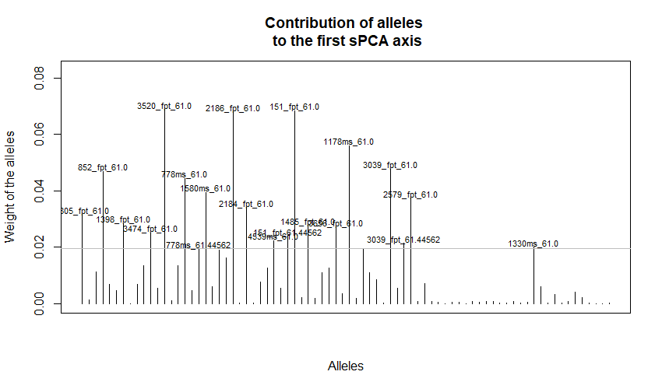
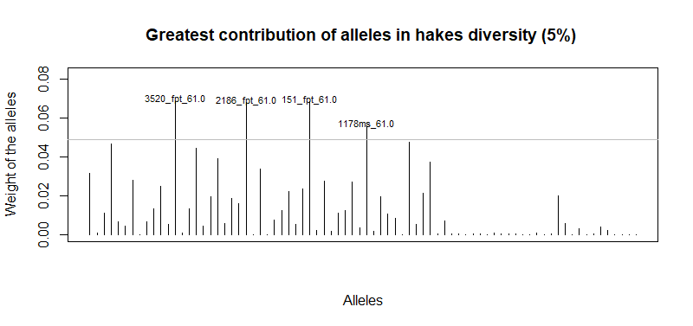
The Figure shows how each allele contributes to a given set of scores (frequency)
5% of alleles with the greatest contributions to the 1st global structure (3520_fpt_61.0", "2186_fpt_61.0", "151_fpt_61.0" and "1178ms_61.0")

Slide 12
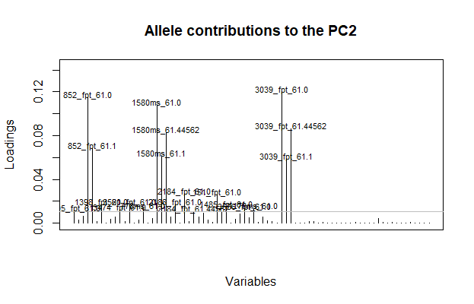
Alleles contributing to the second axis (frequency). 852_fpt_61.0, 1580ms_61.0, 3039_fpt_61.0

Slide 13
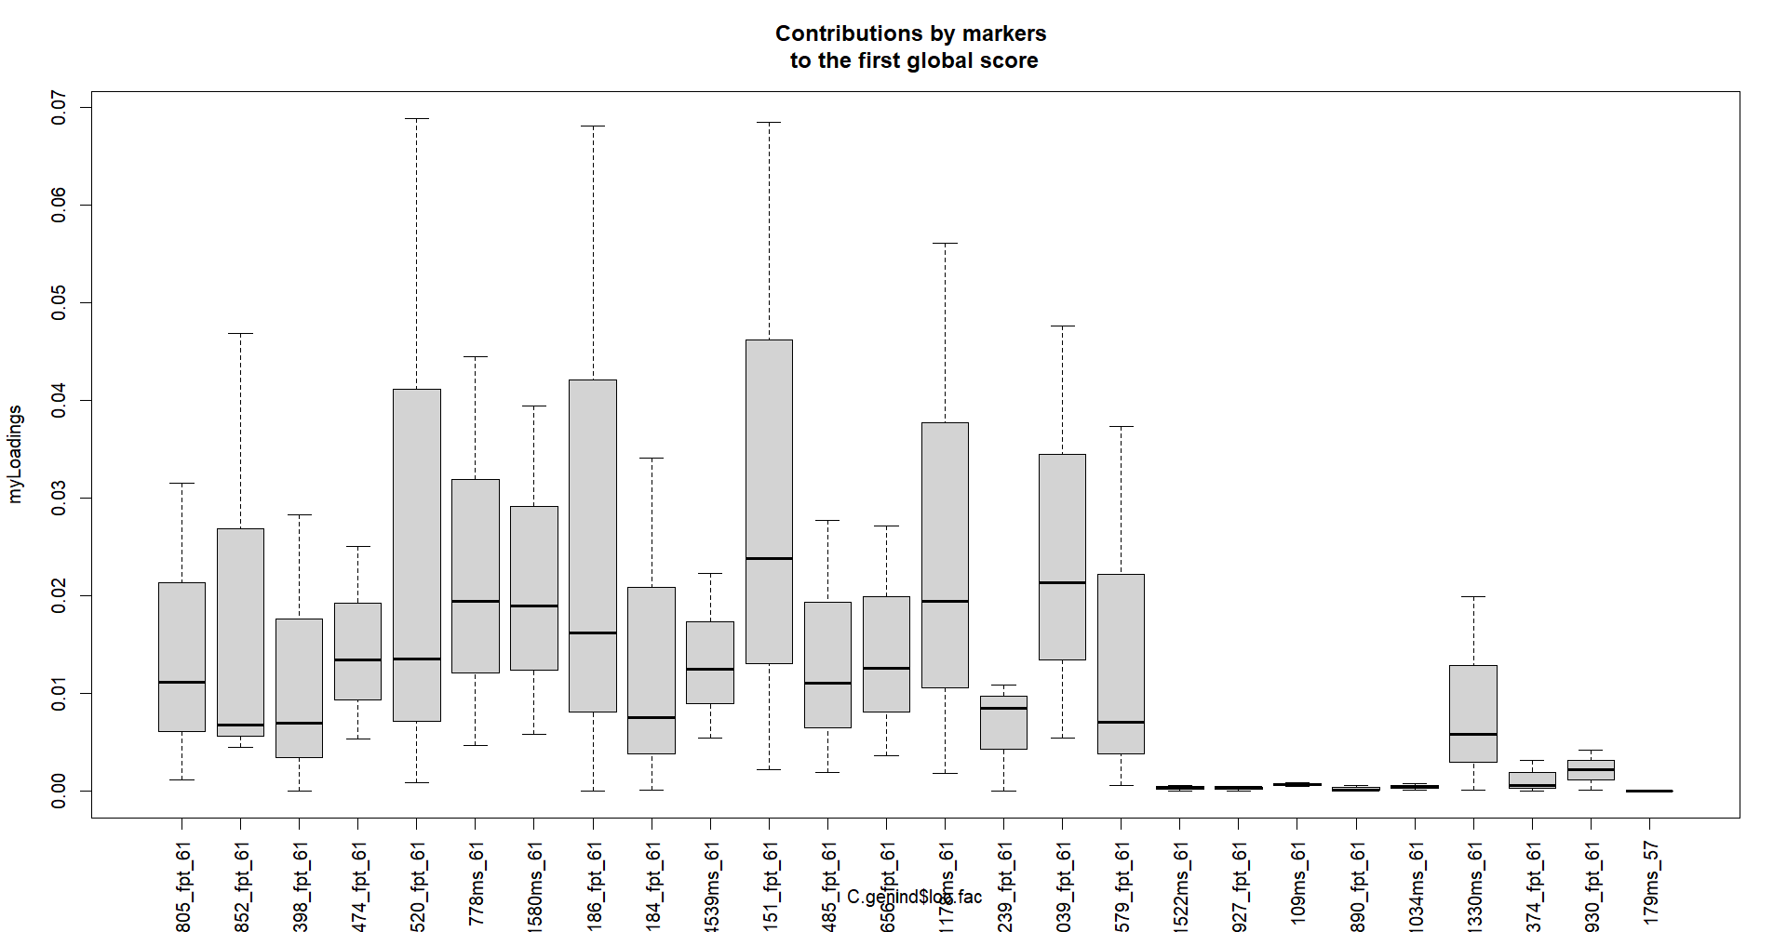
Average contribution of each marker (26 in total)

Slide 14
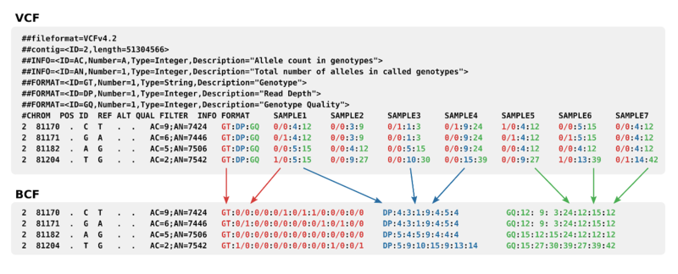
GT (genotype) field test
We searched for the presence of alleles stock outliers carried by the archaeological samples, encoded by a 0 for the REF allele, 1 for the first ALT allele and 2 for the second ALT allele. The representative SNPs are present in most of the archaeological genotypes (43 ancient samples and 850 modern samples), so we can be sure that these results might be accurate and the byas of missing data is not the main cause of their aggrupation.

Slide 15
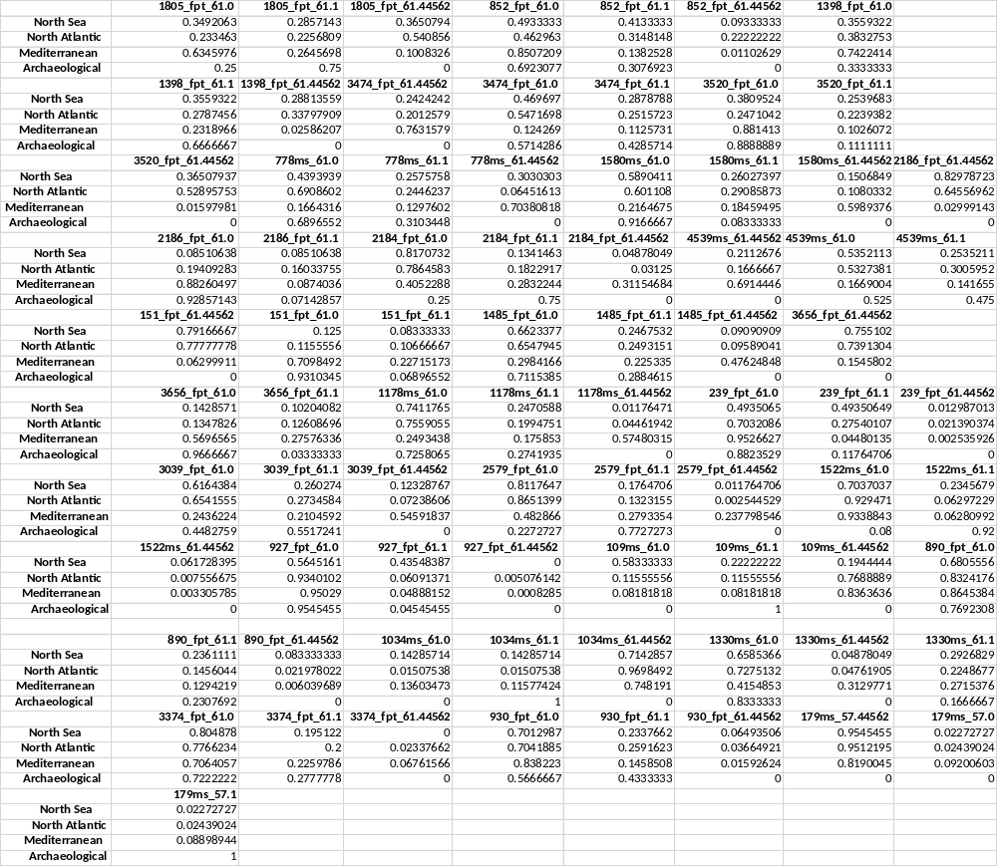
Allele frequencies per population (The genpop object of 4 populations give us as 78 alleles variants from 26 loci)

Slide 16
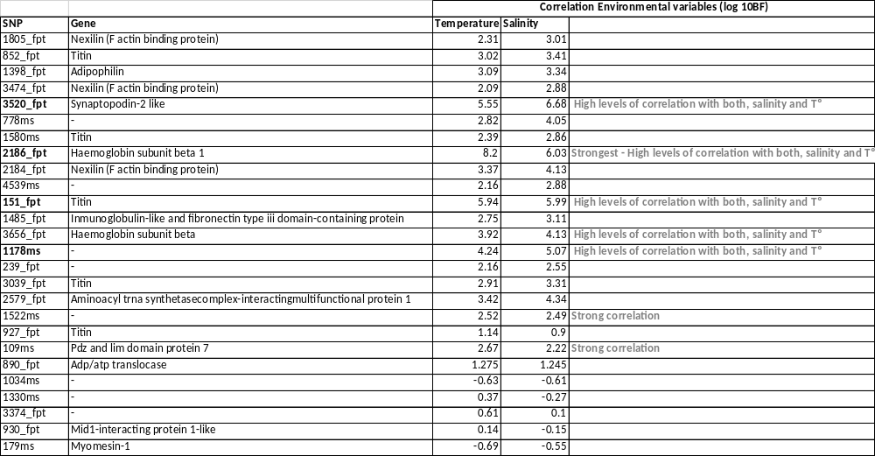
Alleles correlated with environmental conditions (Salinity and Temperature)
* Values of log10BF between 1 and 1.5 indicate a ‘strong’ association. While log10BF>2 designate a ‘decisive’ evidence for correlation.

Slide 17
Frequencies per population of the alleles that mostly contribute to hake genetic diversity and are highly correlated with Salinity and Temperature
 | 3520_fpt_61.0 | 2186_fpt_61.0 | 151_fpt_61.0 | 1178ms_61.0
North Sea | 0.3809524 | 0.08510638 | 0.125 | 0.7411765
North Atlantic | 0.2471042 | 0.19409283 | 0.1155556 | 0.7559055
Mediterranean | 0.881413 | 0.88260497 | 0.7098492 | 0.2493438
Archaeological | 0.8888889 | 0.92857143 | 0.9310345 | 0.7258065
Alleles 3520_fpt_61.0, 2186_fpt_61.0 and 151_fpt_61.0 : high values in MED & Arch, low values in NS & NA. Exception of allele 1178ms_61.0
Strongest correlation with salinity and Tº of the allele 2186_fpt located in the gen Haemoglobin subunit beta 1 .

Slide 18
Frequencies per population of the alleles that mostly contribute to the PC2 (second axis)
 | 852_fpt_61.0 | 1580ms_61.0 | 3039_fpt_61.0
North Sea | 0.4933333 | 0.5890411 | 0.6164384
North Atlantic | 0.462963 | 0.601108 | 0.6541555
Mediterranean | 0.8507209 | 0.2164675 | 0.2436224
Archaeological | 0.6923077 | 0.9166667 | 0.4482759
Alleles contributing to the second axis are 852_fpt_61.0, 1580ms_61.0, 3039_fpt_61.0: high values in, low values in.

Slide 19
(a) Populations clearly differentiate, the archaeological stock share similar character with the Mediterranean and NS with NA
(b) This differences at the gene functional level can suggest local adaptation, could it indicate that Mediterranean and archaeological samples are/were better adapted to their environment ?
(c) Salinity and temperature play a role in survival?, but how this factors might have changed in time?.
(d) How genetic variation in hake populations loci found to be under selection in a time period of 1600 years (s.V to s.XXI?)

Slide 20
HYPOTHESIS
Contemporary evolution by rapid adaptive divergence to climate (Ocean Warming), that is known to occur in marine fish, especially in recent years. Modern stocks originated from allopatric changes from the archaeological stock.
Extinction; having the archaeological hake stock as an extinct ancestral population of the modern stocks. “If one stock is overharvested, for example, will it be replenished by migrants from elsewhere? “ (Conover et al. 2006).
(3) Technological Limitations

Slide 21
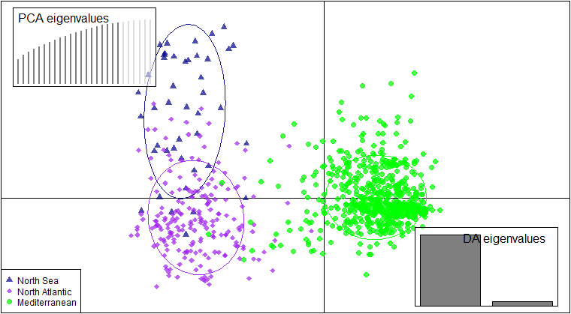
DAPC (Discriminant analysis of principal components)
The objective of this analysis is to summarize the maximum data information to group the samples accurately.
Modern samples DPCA. North Sea (NS) and North Atlantic (NA) stocks seem to share similar characters. 20 first PCs explained de 96% of the total variance

Slide 22
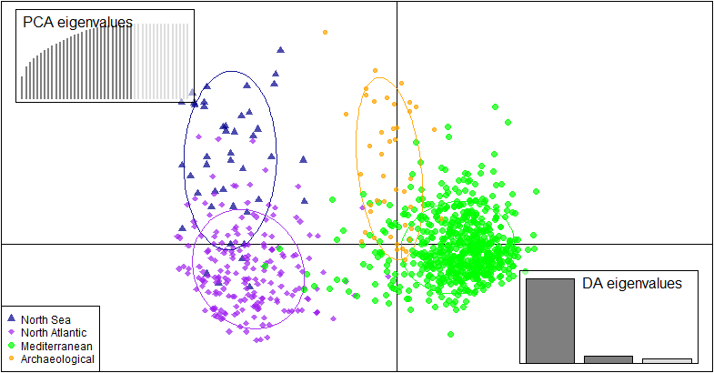
Modern (MED, NA and NS) and 43 archaeological samples DPCA.
Most of the Archaeological samples are closest to the MED.
30 first PCs explained de 99.1% of the total variance

Slide 23
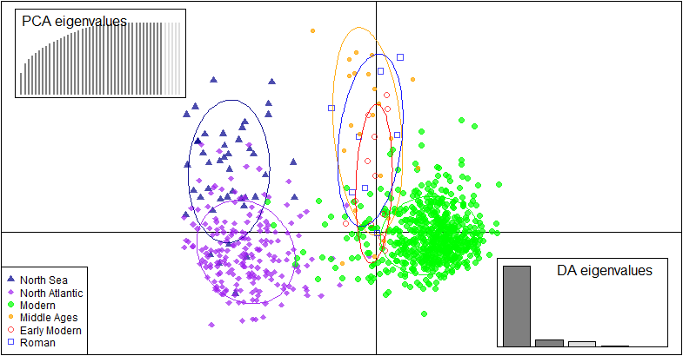
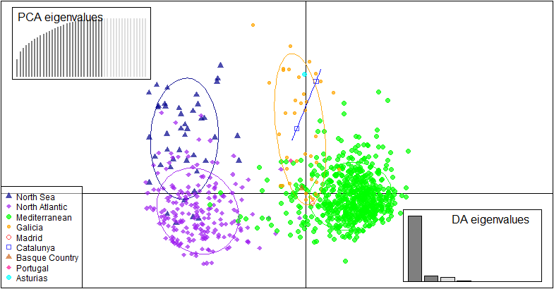
Modern (MED, NA and NS) and archaeological samples DPCA by Time Period.
Modern (MED, NA and NS) and archaeological samples DPCA by Location.
Most of the Archaeological samples are closest to the MED. 40 first PCs explained de 99.9% of the total variance .
Most of the Archaeological samples are closest to the MED. 30 first PCs explained de 99.1% of the total variance

